Slide 1
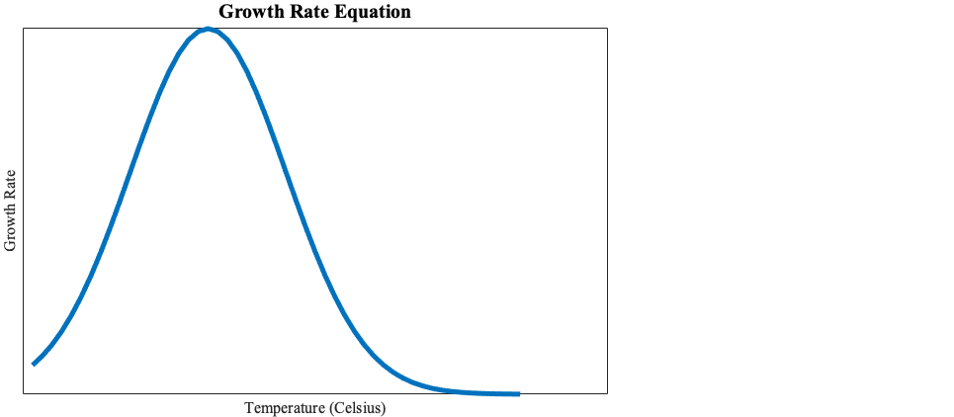
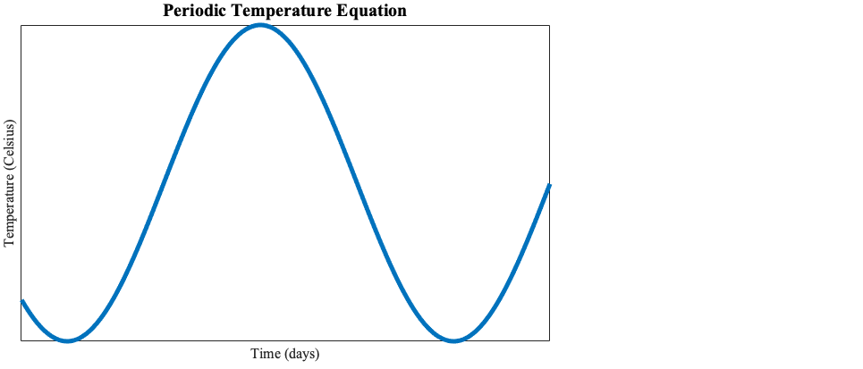
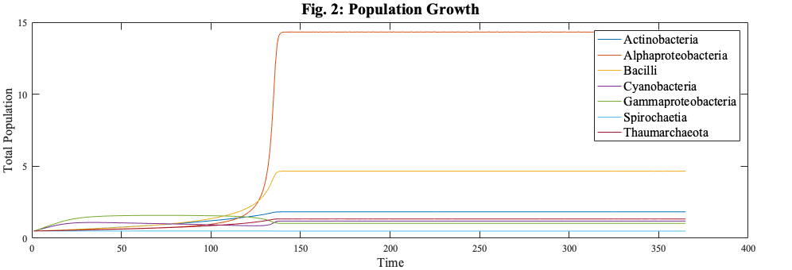
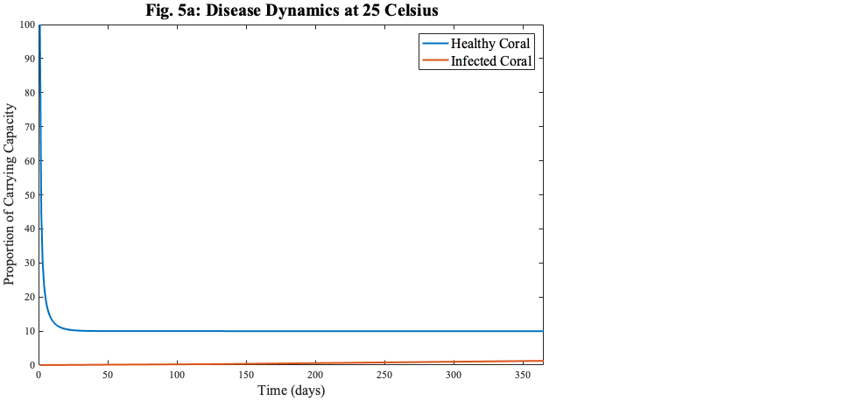
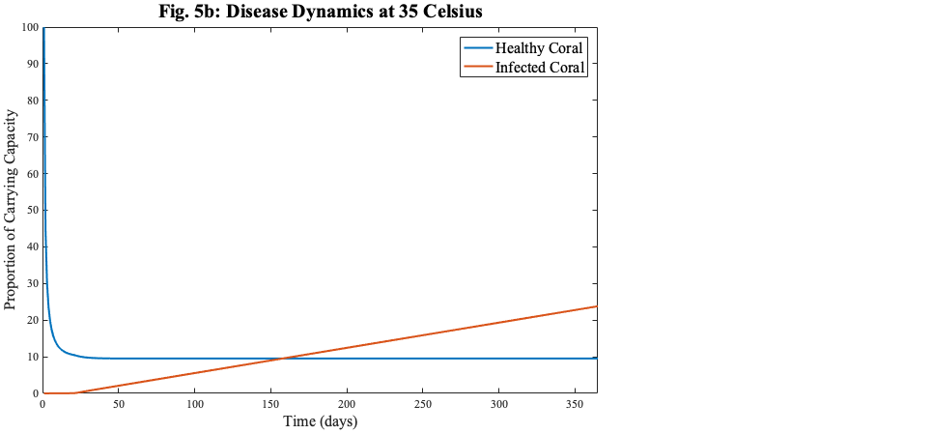
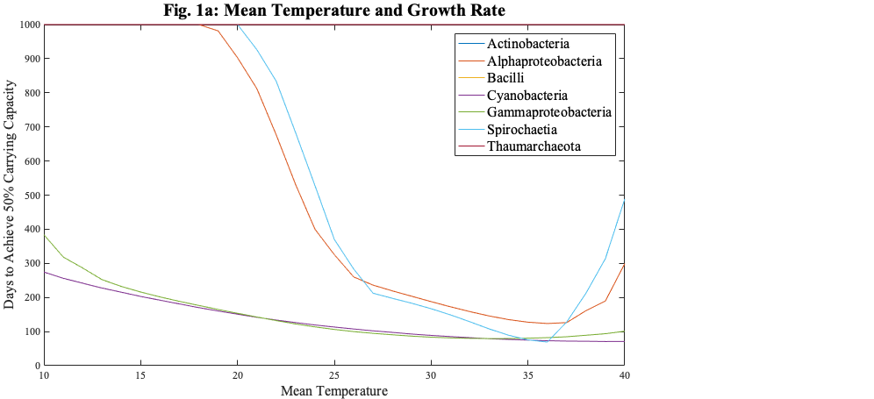
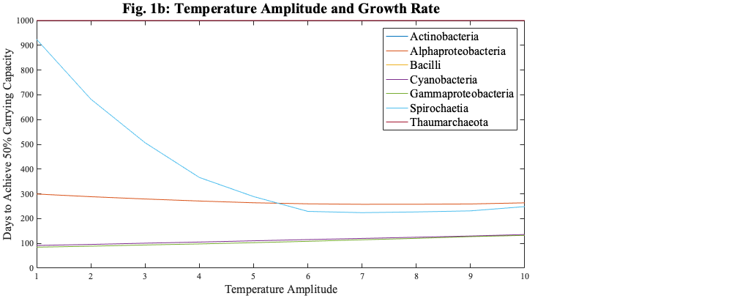
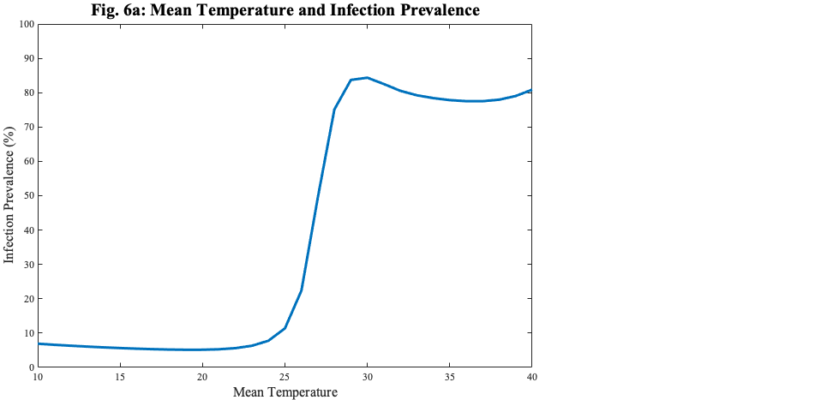
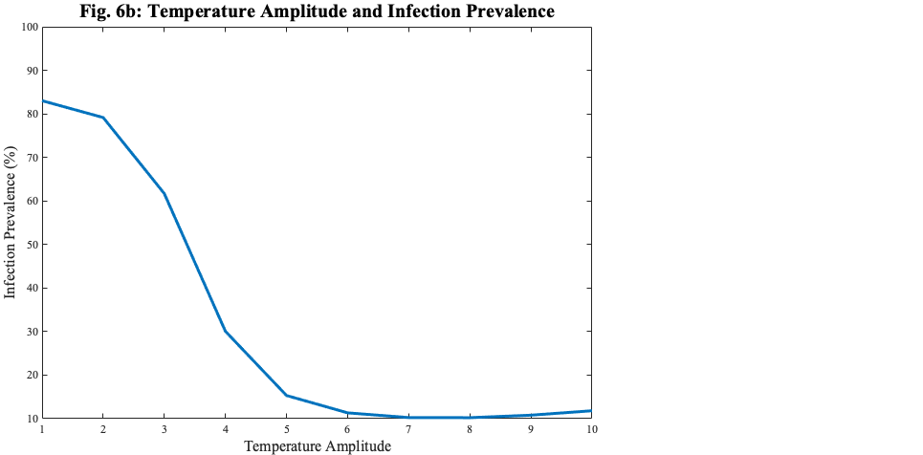
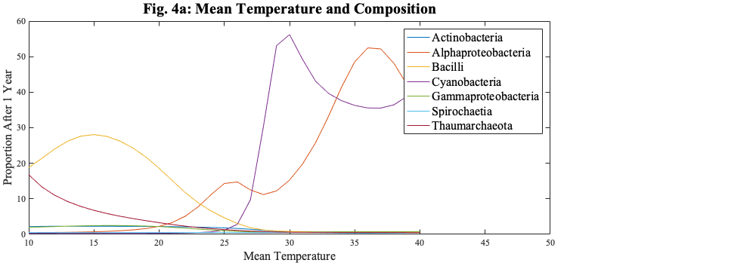
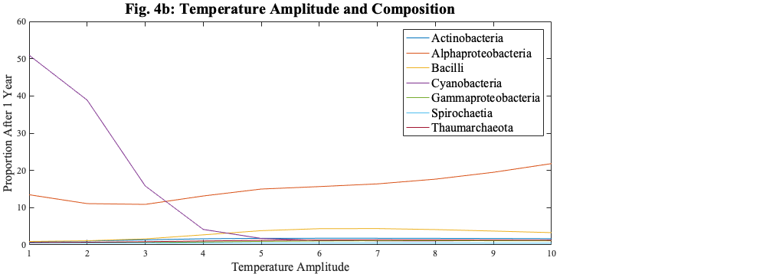


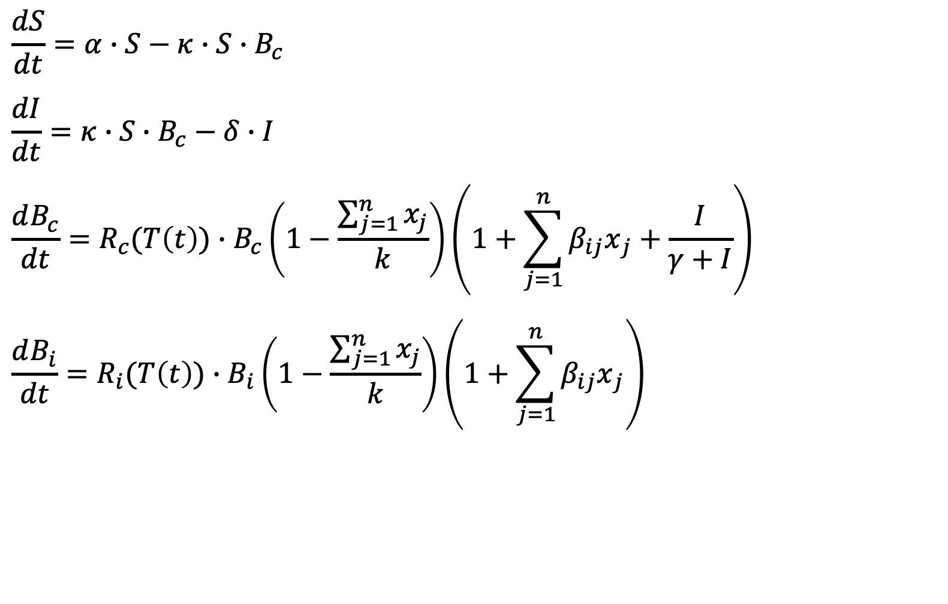
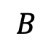
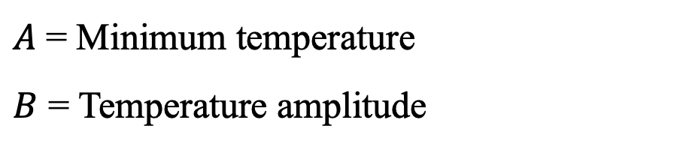
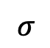
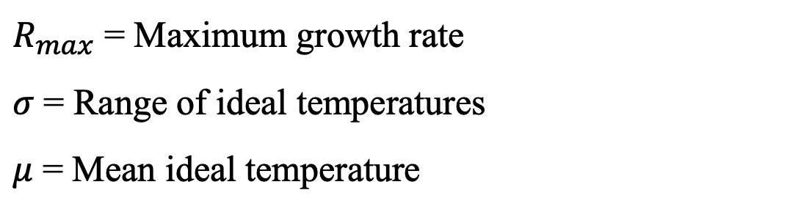
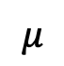
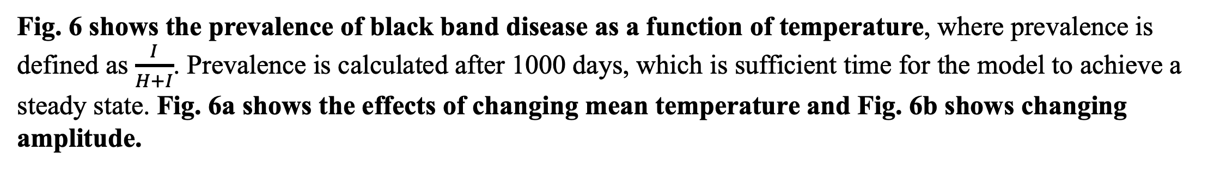

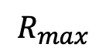
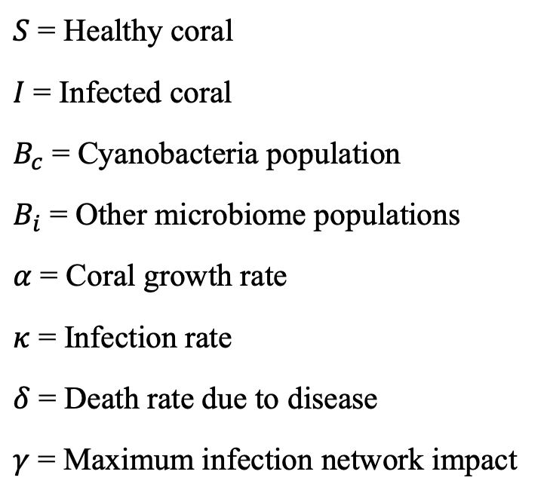
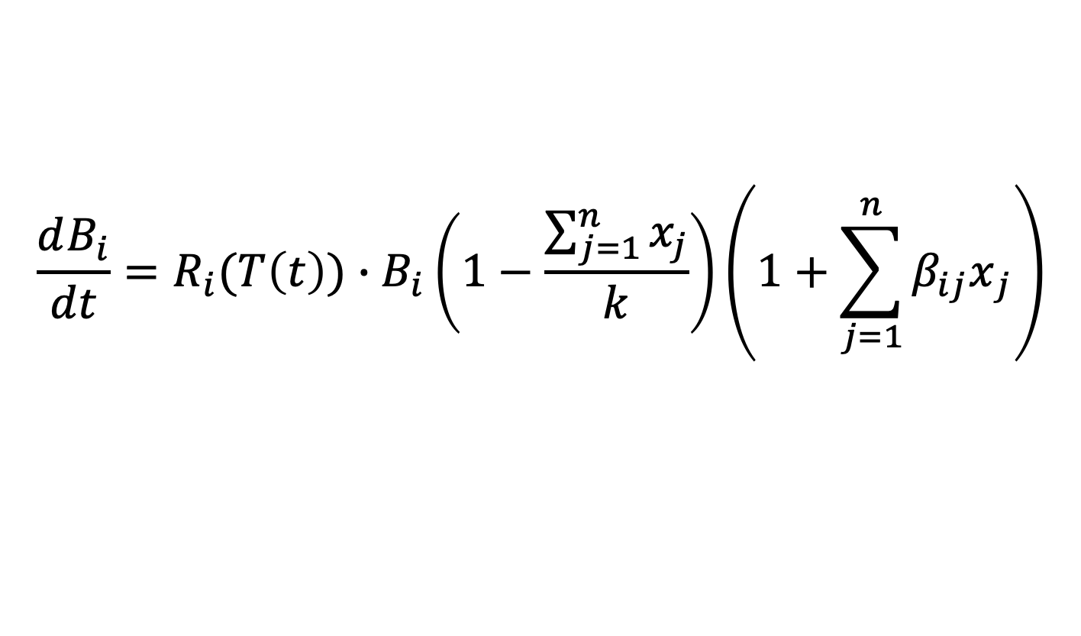
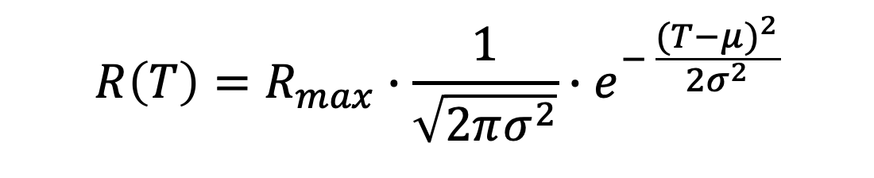
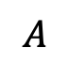
Mathematically modeling the coral reef microbiome
Maya Weissman^{1,3}, Lais Lima^{2,3}, Elizabeth Dinsdale^{2,3}, and Naveen K. Vaidya^{1,3}
¹SDSU Disease Modeling Lab, Dept. of Mathematics and Statistics; ²SDSU Dinsdale Lab, Dept. of Biology; ³SDSU Viral Information Institute
I. Introduction
Coral reefs are home to a quarter of all ocean species, despite covering less than one percent of the earth’s surface.
20% of the world’s reefs have been destroyed due to stressors such as climate change, coral bleaching, and disease.
Coral colonies function as a holobiont, where the coral animal, such as the reef building coral Pseudodiploria strigosa, depend on a complex community of microorganisms.
We hypothesize that temperature drives microbiome composition, which in turn affects the reef’s fitness and its susceptibility to black band disease. Our model takes into account growth rate as a function of temperature, network interactions within the microbiome, and the relationship between the microbiome and black band disease.
Our model was developed using data collected by the Dinsdale Lab. Ocean samples from P. strigosa colonies in Bermuda were sequenced and experimented upon. Using samples from the ocean and heat shock experiments, we are able to parametrize and test the efficacy of our model.
PC: Rob Edwards
II. Isolated Growth
III. Healthy Microbiome Network
IV. Black Band Disease
First, we modeled the isolated growth for each of the seven most abundant genus of bacteria within the microbiome, as determined by the Dinsdale Lab’s shotgun sequencing. We assume no competition or network interactions and that the growth rate is a function of temperature
The microbiome is a complex network of different populations interacting with each other. In this part of the model, we take into account how network interactions affect the composition of the microbiome.
Black band disease is currently a significant threat to P. strigosa. Previous research has shown that black band disease is correlated with an increase in the population of Cyanobacteria. We developed a model that takes into account the positive interaction between the Cyanobacteria population and Infected population
$$\frac{dB}{dt}=R(T\left(t\right))∙B\left(1−\frac{B}{k}\right)$$
B = Genus
R = Growth rate
k = Carrying capacity
T = Temperature
t = Time
$$\frac{dB_{i}}{dt}=R_{i}(T\left(t\right))∙B_{i}\left(1−\frac{\sum_{j=1}^{n}{x_{j}}}{k}\right)\left(1+\sum_{j=1}^{n}{{β_{ij}x}_{j}}\right)$$
Network Analysis: Determined using correlation between species (positive or negative)
$$\frac{dS}{dt}=α∙S−κ∙S∙B_{c}$$
$$\frac{dI}{dt}=κ∙S∙B_{c}−δ∙I$$
$$\frac{dB_{c}}{dt}=R_{c}(T\left(t\right))∙B_{c}\left(1−\frac{\sum_{j=1}^{n}{x_{j}}}{k}\right)\left(1+\sum_{j=1}^{n}{{β_{ij}x}_{j}}+\frac{I}{γ+I}\right)$$
$$\frac{dB_{i}}{dt}=R_{i}(T\left(t\right))∙B_{i}\left(1−\frac{\sum_{j=1}^{n}{x_{j}}}{k}\right)\left(1+\sum_{j=1}^{n}{{β_{ij}x}_{j}}\right)$$
$S$ = Healthy coral
$I$ = Infected coral
$B_{c}$ = Cyanobacteria population
$B_{i}$ = Other microbiome populations
$α$ = Coral growth rate
$κ$ = Infection rate
$δ$ = Death rate due to disease
$γ$ = Maximum infection network impact
Growth Rate: As was determined in Isolated Growth
Competition: Keeps total population below carrying capacity
$$R\left(T\right)=R_{max}∙\frac{1}{\sqrt{2πσ^{2}}}∙e^{− \frac{{(T−μ)}^{2}}{2σ^{2}}}$$
$$T\left(t\right)=A+B∙\sin{(ω∙t+θ)}$$
In Fig. 2, we see the growth rates of the microbiome as they reach a steady state.
$$R_{max}$$
$$B$$
Fig. 5 compares black band prevalence at normal and high temperatures. The graph displays healthy coral growth and infected coral growth as a percentage of carrying capacity.
$$σ$$
$$A$$
Fig. 3 compares the relative proportions of our simulated data at three mean temperatures and data collected by the Dinsdale Lab in Bermuda.
$$μ$$
$R_{max}$ = Maximum growth rate
$σ$ = Range of ideal temperatures
$μ$ = Mean ideal temperature
$A$ = Minimum temperature
$B$ = Temperature amplitude
Fig. 1a illustrates the effect mean temperature has on the time it takes for each population to reach half of the carrying capacity, while Fig. 1b shows the effects of temperature amplitude.
Fig. 6 shows the prevalence of black band disease as a function of temperature, where prevalence is defined as $\frac{I}{H+I}$. Prevalence is calculated after 1000 days, which is sufficient time for the model to achieve a steady state. Fig. 6a shows the effects of changing mean temperature and Fig. 6b shows changing amplitude.
Fig. 4 shows how temperature effects the overall composition of the microbiome. Fig. 4a models a changing mean temperature, while Fig. 4b illustrates changing amplitude.
V. Conclusion
References
Our model is consistent with data collected by the Dinsdale Lab, which makes it a valuable tool in predicting microbiome dynamics.
Temperature can have a significant impact on microbiome composition and coral susceptibility to black band disease. As temperature increases, composition shifts from a larger degree of microbial diversity to being dominated by Cyanobacteria, which has been shown to have a positive correlation to black band disease.
Susceptibility of the coral reef to black band disease can be caused by shifts in temperature.
In the future, we plan to investigate the effect temperature has on the basic reproductive number of black band disease. Due to the periodic nature of temperature, normal methods of finding the basic reproductive number are insufficient. These calculations will help us characterize the environmental threshold conditions that would cause a coral reef to shift from a healthy to a disease associated community.
Further experimentation within the lab is also needed, especially with respect to black band disease. Currently the Dinsdale Lab is working on sequencing more results from the heat shock experiment, which will help us better define our parameters.
Climate change can have a huge impact on the health of the coral reef holobiont. Our model can be used to investigate potential strategies to protect reef ecosystems from black band disease and other stressors.
Meyer, J. L., Gunasekera, S. P., Scott, R. M., Paul, V. J., & Teplitski, M. (2015). Microbiome shifts and the inhibition of quorum sensing by Black Band Disease cyanobacteria. The ISME journal, 10(5), 1204-16.
Marino, S., Baxter, N. T., Huffnagle, G. B., Petrosino, J. F., & Schloss, P. D. (2014). Mathematical modeling of primary succession of murine intestinal microbiota. PNAS, 111(1), 439-44.
Acknowledgements
NSF Grant DMS-1616299 (NKV)
NSF Grant DMS-1836647 NKV
NSF Grant OCE-0928406 (ED)
SDSU DiMoLab
SDSU Dinsdale Lab
SDSU Viral Information Institute
Rob Edwards
Karl Parks

